Slide 1

NAU Mathematics & Statistics Research Showcase Website
A Centralized Platform for Academic Excellence
Ethan Ferguson | Jack Tomlon | Karl Reger | Rylan Harris-Small

Slide 2





The Challenge We're Solving
Problem Statement:
The lack of a centralized, structured platform for storing and showcasing Mathematics and Statistics student research affects students, faculty, and external evaluators, resulting in diminished research visibility, ineffective knowledge-sharing, and lost academic and professional opportunities.
Pain Points:
Students: Where is my research stored?
Faculty: How do I find past projects?
External Evaluators: What quality research exists?
Notes:
The Mathematics and Statistics Department currently lacks a centralized, structured platform for storing and showcasing student research. (click) This creates three significant challenges:
(click)
First, students struggle to showcase their academic work. After completing excellent research projects, there's no standard way to make them visible to employers or graduate schools. These projects often end up forgotten on personal drives or printed as posters that eventually get discarded.
(click)
Second, faculty cannot easily reference past projects. When advising new students or developing curriculum, professors have no straightforward way to access the wealth of knowledge created by previous students, leading to unnecessary duplication of effort.
(click)
Third, external evaluators such as graduate schools and potential employers have difficulty assessing the department's research output. Without a centralized repository, the impressive work being done remains largely invisible outside the department.
The cumulative impact of these challenges is diminished research visibility, ineffective knowledge-sharing, and lost academic and professional opportunities. This is the problem we've set out to solve.

Slide 3

Our Solution: A Research Showcase Platform
Value Proposition
Unique Advantages
For students, faculty, and external evaluators who need a reliable and structured platform to manage and discover research, the Mathematics & Statistics Research Showcase is a web-based academic repository that streamlines research submission, display, and discovery.
Faculty-driven submission process
Administrative quality control
Advanced search capabilities
Secure role-based access
Notes:
Our solution is the Mathematics & Statistics Research Showcase, a web-based academic repository specifically designed for the department's needs.
(click)
Our value proposition is clear: For students, faculty, and external evaluators who need a reliable and structured platform to manage and discover research, this showcase streamlines the entire process from submission through display to discovery.
(click)
Unlike current ad hoc solutions such as GitHub repositories or hallway posters, our platform offers four key advantages:
First, a faculty-driven submission process ensures that only legitimate student research enters the system, with proper academic oversight.
Second, administrative quality control allows department leaders to maintain high standards through a structured approval workflow.
Third, advanced search capabilities make finding specific research straightforward, whether you're looking by topic, advisor, or keywords.
Finally, secure role-based access ensures that the right people have the right permissions—faculty can submit, administrators can approve, and visitors can browse.
This approach transforms how research is managed, making it accessible while maintaining high academic standards.

Slide 4



The Human Side: Key User Stories
Faculty Story
Administrator Story
Visitor Story
"As a Math Professor, I want to store student capstone projects in a central location so I can reference them easily when advising new students."
"As a department administrator, I want to review research submissions before they go public so we maintain consistent quality standards."
"As a graduate school applicant, I want to search for research by keywords and faculty advisors so I can find projects relevant to my interests."
Notes:
To ensure our solution addresses real needs, we developed key user stories that guided our design decisions. These stories represent three of the primary stakeholders in our system.
(click)
From the faculty perspective: 'As a Math Professor, I want to store student capstone projects in a central location so I can reference them easily when advising new students.' This highlights the need for faculty to have an organized repository of past work that informs their teaching and mentoring.
(click)
From the administrator perspective: 'As a department administrator, I want to review research submissions before they go public so we maintain consistent quality standards.' This story emphasizes the importance of quality control to preserve the department's academic reputation.
(click)
From the visitor perspective: 'As a graduate school applicant, I want to search for research by keywords and faculty advisors so I can find projects relevant to my interests.' This story shows how external users need efficient ways to discover relevant content.
These three stories encapsulate the core needs our system addresses, ensuring we built something truly useful for all stakeholders.

Slide 5

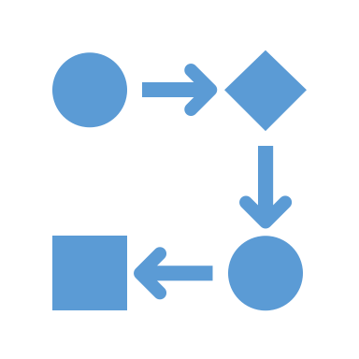


Core Functional Requirements
Faculty Research Submission
Admin Approval Workflow
Role-Based Access Control
Advanced Search & Filtering
Submit metadata & multiple file types
Associate with student authors
Review submissions
Approve, reject, or request revisions
Faculty: submission privileges
Admins: approval authority
Visitors: browsing access
Filter by keyword, category, advisor
Find specific research content quickly
Notes:
Based on our user stories, we identified four core functional requirements that form the foundation of our system.
First, the Faculty Research Submission Portal allows professors to submit student research by entering metadata like title, student authors, and research category, along with uploading multiple file types including PDFs, presentations, and images. This creates the entry point for all content in the system.
Second, the Admin Approval Workflow enables department administrators to review submissions and make quality control decisions. They can approve research for publication, reject unsuitable submissions, or request specific revisions from faculty. This ensures all published content meets departmental standards.
Third, Role-Based Access Control enforces appropriate permissions throughout the system. Faculty members can submit and manage their submissions, administrators can review and approve content, and visitors can browse and search the approved repository. This security model protects the integrity of the research collection.
Fourth, an Advanced Search and Filtering System allows users to find relevant research using keywords, categories, faculty advisors, dates, and file types. This makes the repository truly useful for research and reference purposes.
Together, these requirements create a complete workflow from submission through approval to discovery, addressing all user needs identified in our research.

Slide 6
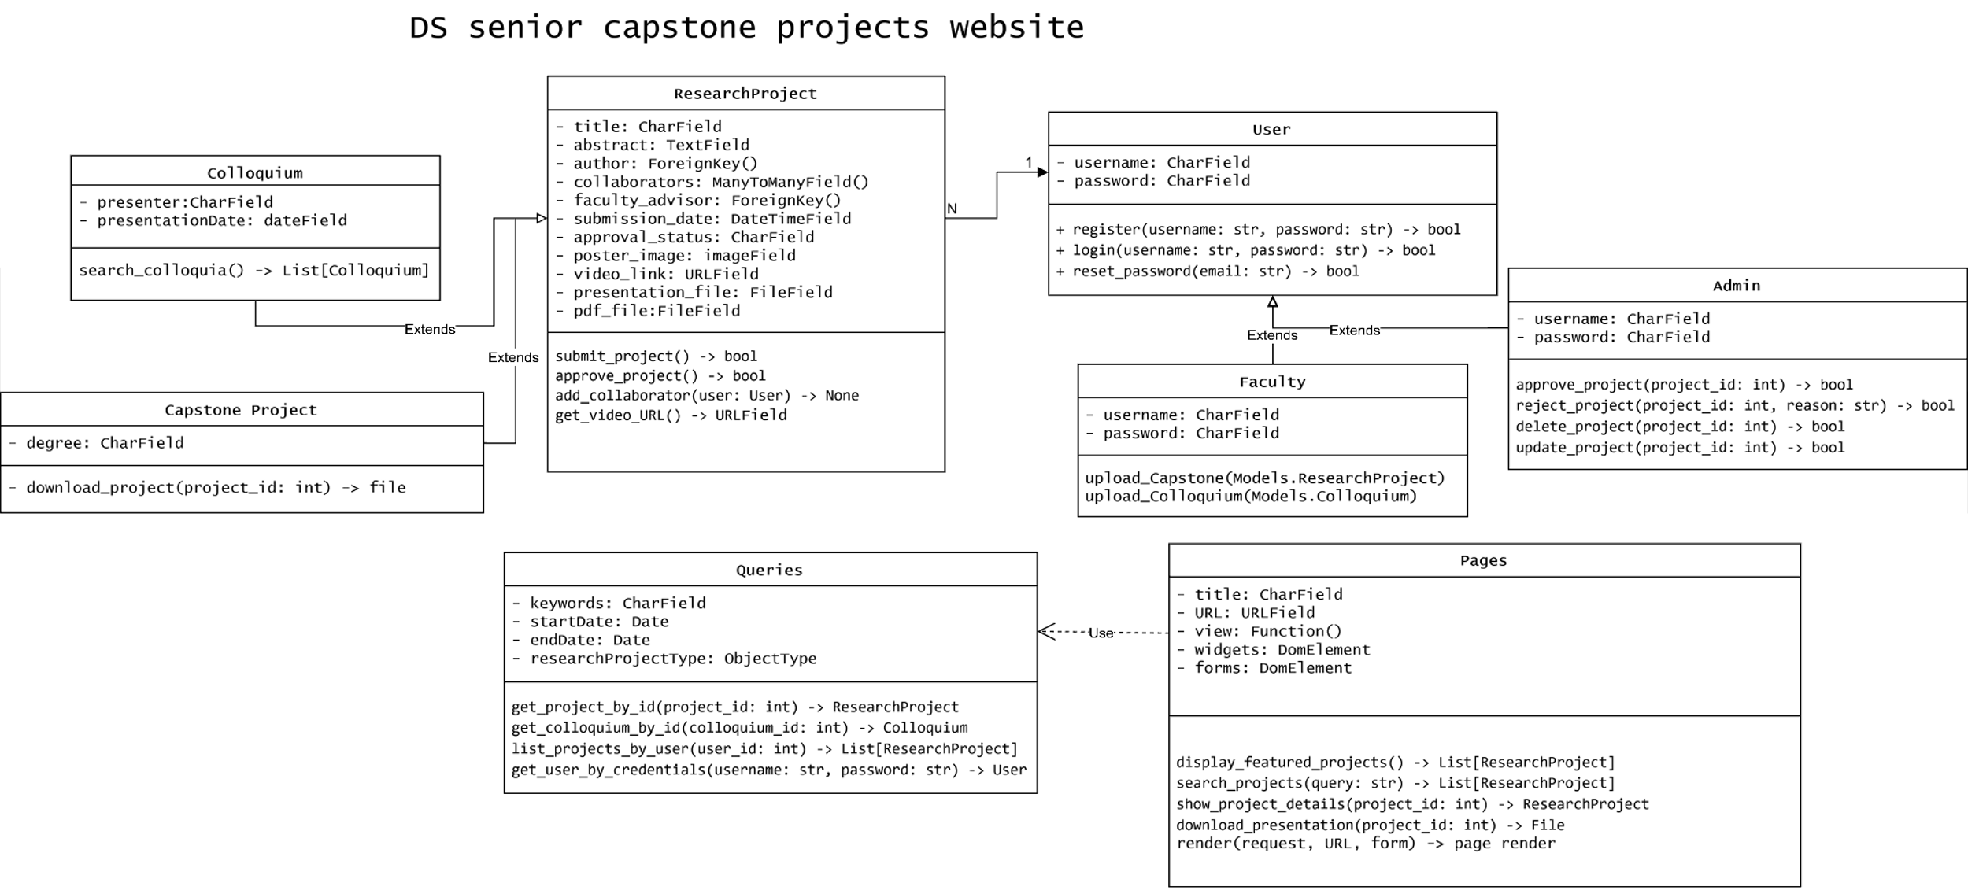
System Interactions: Use Case Diagram
PHOTO
Notes:
This UML Use Case diagram provides a visual representation of how different actors interact with our system. The diagram captures all possible interactions between users and the Research Showcase platform.
On the upper right, we have our three actor types: Faculty, who initiate the content submission process; Administrators in the middle, who handle content approval; and other uses or "visitors" at the top, who consume the approved research.
The functions at the bottom represent the system use cases—the actions that users can perform. Faculty can Upload Research, initiating the content flow. Administrators can Approve or Reject Research submissions and can also Delete or Revise when necessary. Users, along with Faculty and Administrators, can Browse Research and Search Research using Queries to display relevant Pages.
The connecting lines show which actors can perform which actions. Notice how the permissions are appropriately limited—only Faculty can submit, only Administrators can approve or request revisions, but all users can browse and search.
This diagram was instrumental in defining the boundaries of our system and ensuring we addressed all necessary interactions.

Slide 7
Who Are the Key Actors?
Faculty
Administrators
Visitors
Content contributors
Research mentors
Primary authenticated users
Content gatekeepers
Quality control
System managers
Students seeking examples
Graduate schools evaluating applicants
External collaborators exploring opportunities
Notes:
Let's examine the three key actors in our system in greater detail to understand their roles and responsibilities.
(click)
Faculty members serve as the content contributors in our system. They are the research mentors who guide students through their projects and ultimately submit those projects to the repository. As primary authenticated users, they have special permissions to upload content and track its status.
(click)
Administrators function as content gatekeepers, ensuring that only high-quality, appropriate research is published. They manage the quality control process and have the authority to approve, reject, or request changes to submissions. They also manage system settings and user accounts as needed.
(click)
Visitors comprise a diverse group including current students seeking examples, graduate schools evaluating applicants, and external collaborators exploring potential partnerships. They have read-only access to approved content but can utilize the full search and browsing capabilities.
The relationship between these actors forms a complete content lifecycle—faculty create, administrators validate, and visitors consume. This clear separation of responsibilities helps maintain system integrity while serving all stakeholders effectively.

Slide 8
Four Critical System Interactions
Use Case 1: Submit Research
Use Case 2: Approve/Reject Research
Use Case 3: Browse Research
Use Case 4: Search Research
Faculty uploads files and metadata
System validates submission
Content enters the review queue
Admin reviews submission details
Decision made on appropriateness
Notification sent to faculty
Visitors navigate categorized content
System displays approved research
Files and details accessible
Users enter search criteria
System filters database
Relevant results displayed
Notes:
We've identified four critical use cases that represent the core functionality of our system. These use cases capture the essential interactions that make the platform valuable.
(click)
Use Case 1 is Submit Research. Here, a faculty member uploads files and metadata about a student project. The system validates the submission for completeness and required fields, then places the content in a review queue while notifying administrators.
(click)
Use Case 2 is Approve/Reject Research. An administrator reviews the submission details, makes a decision based on quality and appropriateness, and provides optional feedback. The system then updates the submission status and notifies the faculty member of the decision.
(click)
Use Case 3 is Browse Research. Visitors navigate through categorized content using faculty names, research topics, or dates. The system displays approved research in a structured format, making files and details easily accessible.
(click)
Use Case 4 is Search Research. A user enters specific search criteria like keywords or advisor names. The system filters the database according to these parameters and displays relevant results in a list.
(click)
These four use cases work together to create a complete research management ecosystem—from contribution through validation to discovery. The submission and approval process ensures quality, while browsing and searching enable accessibility.

Slide 9
System Architecture: Class Diagram (UML)
PHOTO
Notes:
This UML Class diagram illustrates the technical architecture of our system. It shows the key data structures and their relationships that power the Research Showcase platform.
At the center of our architecture is the User class, which implements the role-based access control system. It contains attributes for username, email, and critically, the role attribute that determines permissions. User methods include authentication functions and role verification.
The ResearchProject class is our core data structure, containing attributes for title, abstract, submission date, and approval status. It also manages file references for PDFs, presentations, and images. This class has relationships with the User class—a faculty user submits projects, while many users may collaborate on a single project.
The Admin class extends User with additional approval methods, while Faculty extends User with submission capabilities. The Colloquium class represents a related but separate content type for the department's speaker series.
Search functionality is implemented through query methods that interact with the ResearchProject class, while the notification system connects users to the content lifecycle events.
This architecture provides a solid foundation that aligns with our functional requirements while allowing for future expansion as the department's needs evolve.

Slide 10
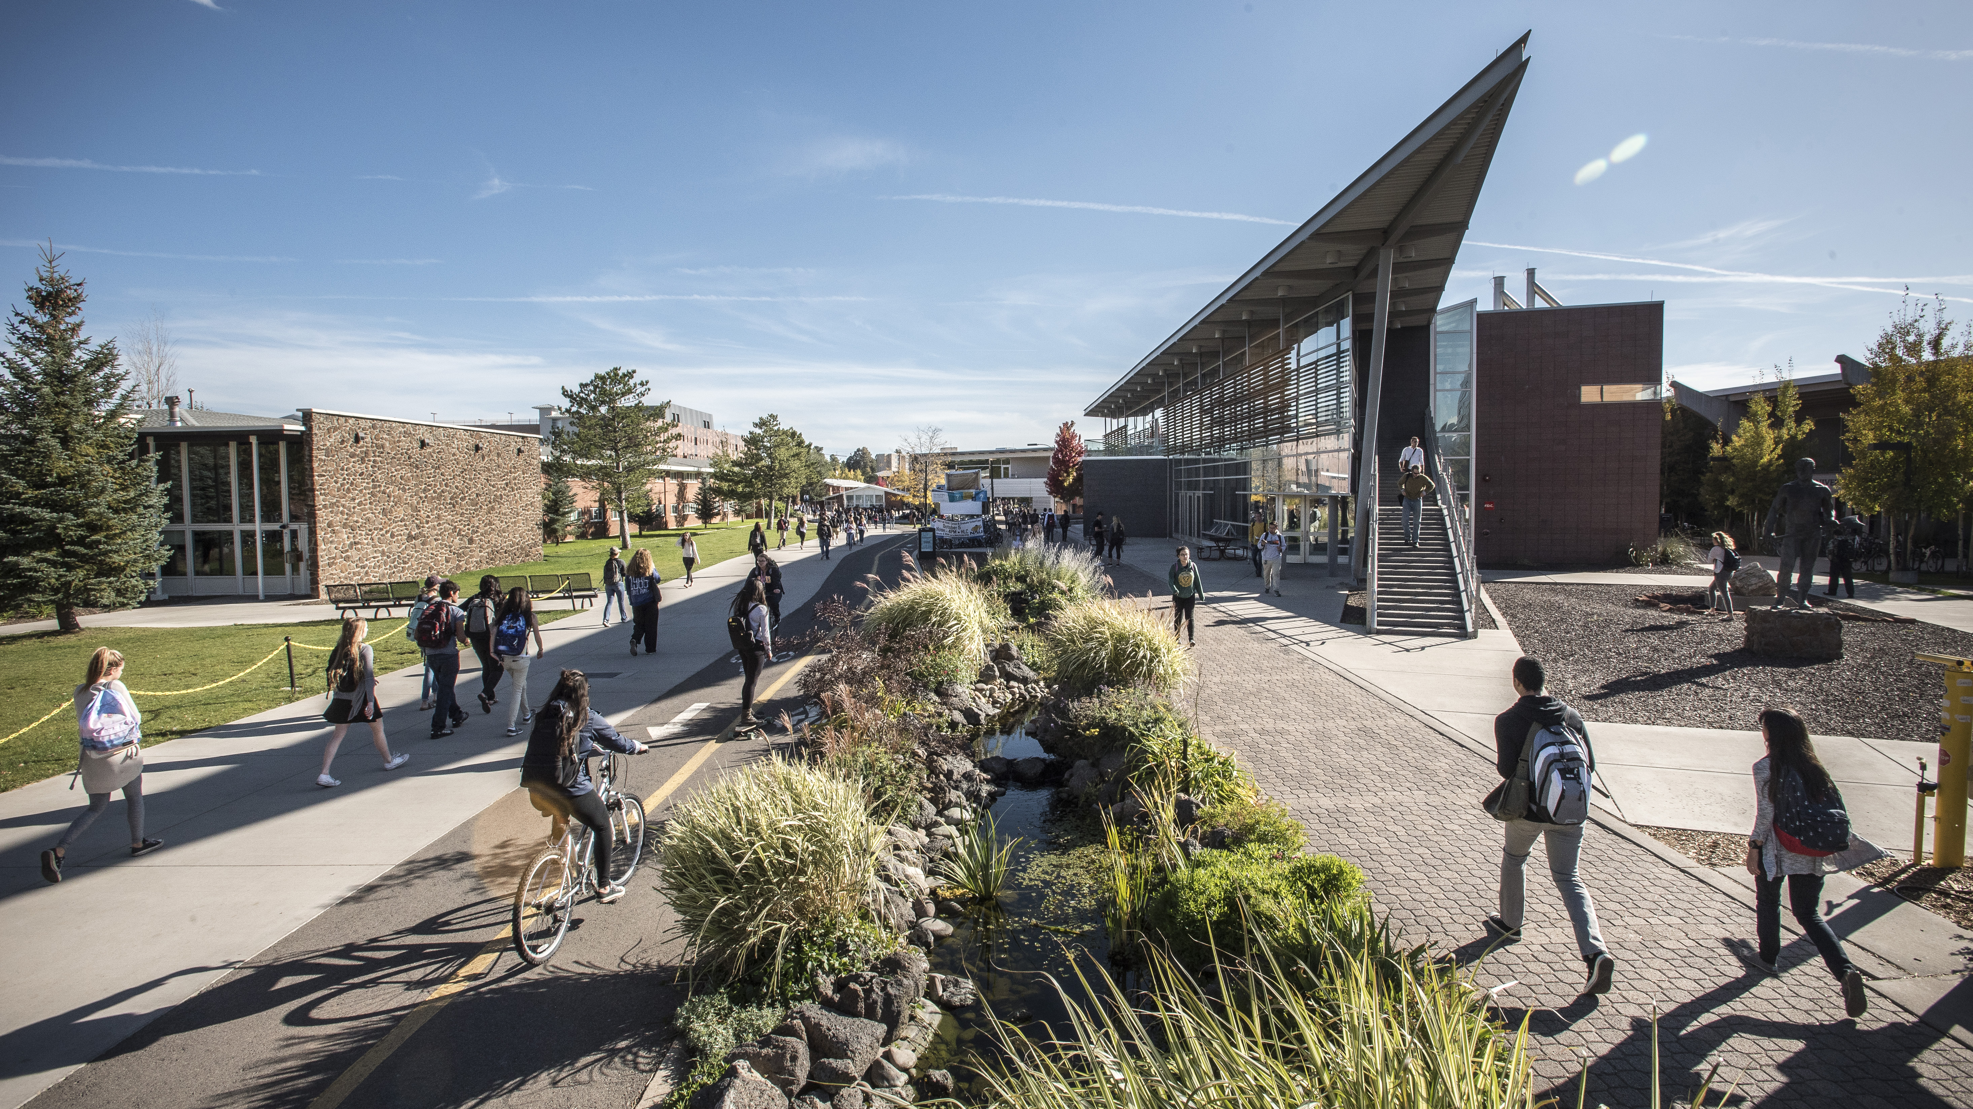
THANK YOU!
Team 14: Ethan Ferguson, Jack Tomlon, Karl Reger, Rylan Harris-Small Repository: github.com/Naalu/ds-senior-capstone-projects-website
Notes:
Thank you for your attention today. We've walked through the Mathematics & Statistics Research Showcase from problem identification through solution design to technical implementation.
To recap: We've created a solution that addresses the department's need for a centralized research repository through a faculty-driven submission process, administrative quality control, role-based access, and powerful search capabilities.
Our implementation plan includes three key phases: Initial implementation in March 2025, beta testing with selected faculty in April 2025, and a department-wide rollout in May 2025.
We welcome your questions and feedback as we move forward with this project. You can reach our team—Ethan Ferguson, Jack Tomlon, Karl Reger, and Rylan Harris-Small—through the contact information displayed, or explore our technical documentation at the GitHub repository. We're excited to implement this solution and provide the Mathematics and Statistics Department with a professional platform for showcasing student excellence. Thank you.

